Slide 1

1. Simplify the expression given below.
2. Simplify the expression below. Give your answer in standard form.
A. C. B. D.
3. Simplify the expression below. Give your answer in standard form.
4. Simplify the expression below. Give your answer in standard form.
© Gina Wilson (All Things Algebra), 2012-2018
Factor each polynomial completely.
5.
6.
7.
8.

Slide 2


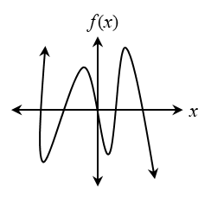
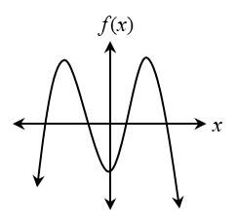
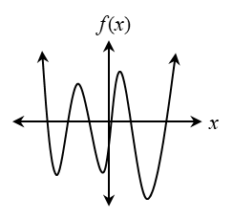
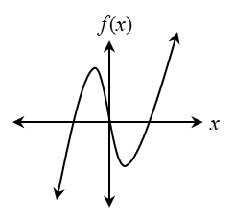

9. Graph the function and identify all key characteristics:
Domain: _____________________________________ Range: ______________________________________ Rel. Maximum(s): ____________________________ Rel. Minimum(s): _____________________________ Inc. Intervals: _______________________________ Dec. Intervals: ______________________________ Zeros: ______________________________________
End Behavior: As _______ As _______
10. If an even-degree polynomial function has a positive leading coefficient, which graph could represent this function?
A. B. C. D.
11. Which of the following describes the end behavior of the function below? Check all that apply.
As
As
As
As
12. Identify the zeros, their multiplicity, and the effect (bounces or intersects) on the graph of the function given below.
13. The graph of a polynomial function has zeros of 3 (multiplicity 2), and -7 (multiplicity 1). Write a function in standard form that could represent this function.
Zero | Multiplicity | Effect

Slide 3


Solve each equation by factoring. Simplify all irrational and complex solutions.
14.
15.
16.
17.
18. Which of the following represents the zeros of the function f(x) = x³ + 512? Check all that apply.

Slide 4

Find the quotient.
19.
20.
21.
22.
23. Kyle ran for 30 minutes. His elevation f (in feet) x minutes into his run can be represented by the function f(x) = 0.04x³ – 2x² + 24x + 150. Using the Remainder theorem, find his elevation halfway through his run.

Slide 5

Use f(x) = x² – x, g(x) = 9 – 2x, and h(x) = x² + 2x – 63 for questions 24-29.
24. Find
25. Find
26. The domain of the function is all real numbers except -
27. Find
A. -9 and 7 B. -7 and 9 C. -9, 0 and 7 D. -7, 0 and 9
28. Evaluate .
29. Evaluate .
30. The data below shows the attendance at a water park over five days. Write a quartic function to model the data, then estimate the attendance at the park on the 8th day.
Day | Attendance
1 | 605
2 | 921
3 | 977
4 | 1,037
5 | 1,221
Equation:
Attendance:

